Slide 1
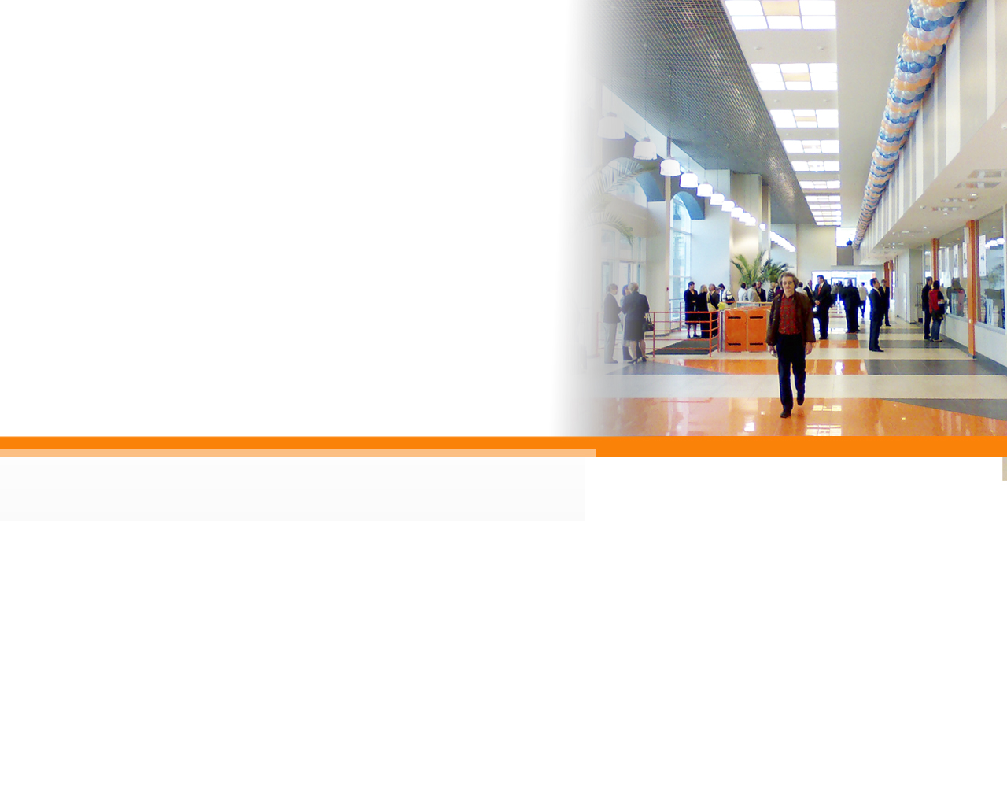

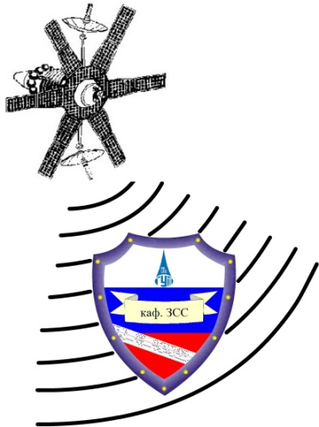


Security Mechanism:
Authorization

Slide 2

Authorization Core Concepts
Is the user allowed to perform this action, within this context?
1st
Should the user be allowed this function at all?
2nd
Should the user have only limited context access?
Notes:
Authorization is the act of verifying that a previously authenticated user is allowed to perform a given operation or act on a given resource, and is often known as access control. There are actually two things going on here. The first is a check to verify that the user is allowed to visit a section of the application or perform a certain function. For example, is the user allowed to delete records? Maybe this is only reserved for administrators? The second is a check to verify that the user is allowed to work within the specified context. For example, after verifying that the user is allowed to use the delete record functionality, we then need to verify that the user is allowed to delete the specific record in question.

Slide 3
Authorization Words to Live By
Every function (page) must verify authorization to access
Every function (page) must verify the access context
Any client/server application must verify security on server
Notes:
There are three words to live by related to authorization that we as developers must keep in mind. The first is to verify that the user is allowed to access the requested page or function. The second is to verify that the user can operate within the given context. For example, can the user read everyone's mail or just their own? And finally, related specifically to client-server applications, we must make sure that any authorization check is done on the server as client side security can often be bypassed.

Slide 4
Authorization Words to Live By: #1
Every function (page) must verify authorization to access
CWE-425: Direct Request ('Forced Browsing')
  When access control checks are not applied consistently (or not at all) users are able to access data or perform actions that they should not be allowed to perform. This can lead to a wide range of problems, including information exposures, denial of service, and arbitrary code execution.
Notes:
The first of our words to live by in the area of Authorization is "every function (page) must verify authorization to access". This corresponds to CWE-425 titled "Direct Request ('Forced Browsing')". Applications are often susceptible to direct request attacks when a false assumption is made that resources can only be reached through a given navigation path and developers only applied authorization at to the start of that path. Any alternative paths that exist would bypass the authorization check put in place.

Slide 5
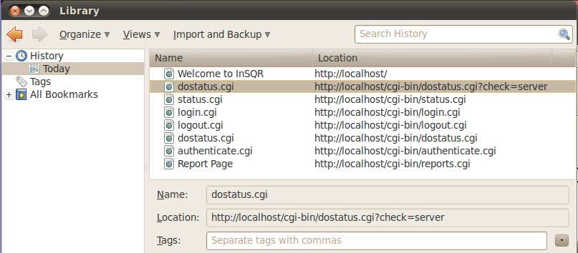
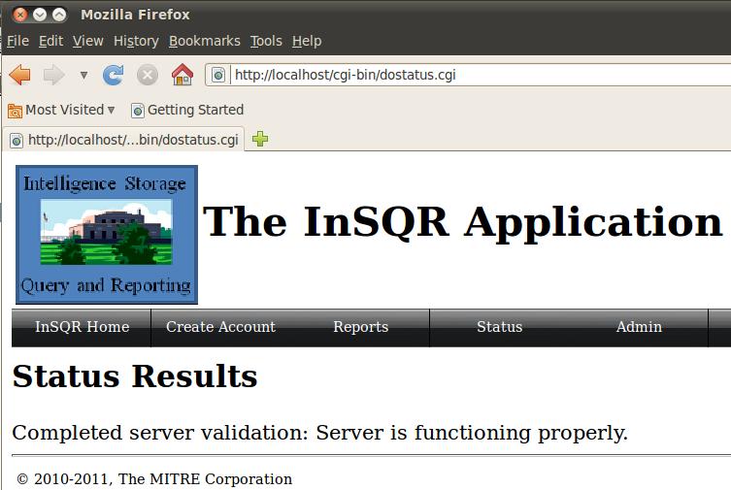
Not Protecting All Pages – Exploit Demo
Notes:
Demo – Should have previously demonstrated the basic functionality of the site while logged in as our ‘popped’ account. Demonstration of the various status views can be performed. Click the logout button to remove the credentials and then show that the ‘status’ button no longer lets you get access to that functionality without logging in. Then show bringing up the browser history with control-shift-H, and drilling into the recent URLs. Demonstrate that by going directly to the actual dostatus.cgi without using the form frontend, the CGI isn’t verifying the user’s authorization to the page/function.

Slide 6
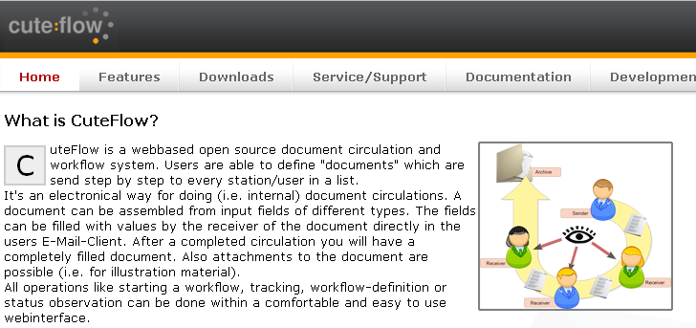
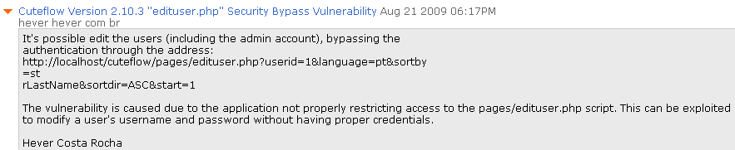
Real World Example – CuteFlow Exploit
Notes:
In this example, CuteFlow, which is a document workflow tracker, was supposed to verify a user's access to certain pages before granting permission to use the functionality on the page. Here, an attacker is trying to gain access to the edituser functionality. Under normal conditions, the user would first browse to edituser.php where he would be authorized before being redirected to the actual edituser functionality. Unfortunately, this authorization check could be bypassed by supplying the userid in the URL. Upon seeing the userid in the URL, the edituser script then assumed authorization had already been performed and proceeded to perform the specified function.
By directly editing this URL, an attacker could easily edit any user's information including their username and password. This included the admin user which more often than not is assigned a userid of 1.

Slide 7
Authorization Words to Live By: #2
Every function (page) must verify access context
CWE-639: Access Control Bypass Through User-Controlled Key
  The system's access control functionality does not prevent one user from gaining access to another user's records by modifying the key value identifying the record.
Notes:
The second words to live by is "every function (page) must verify access context". This corresponds to CWE-639 titled "Access Control Bypass Through User-Controlled Key". The example most commonly seen is an attacker changing the web address that contains an id of a resource, and the altered request being processed by the server without verifying authorization, resulting in access to the resource being granted.

Slide 8
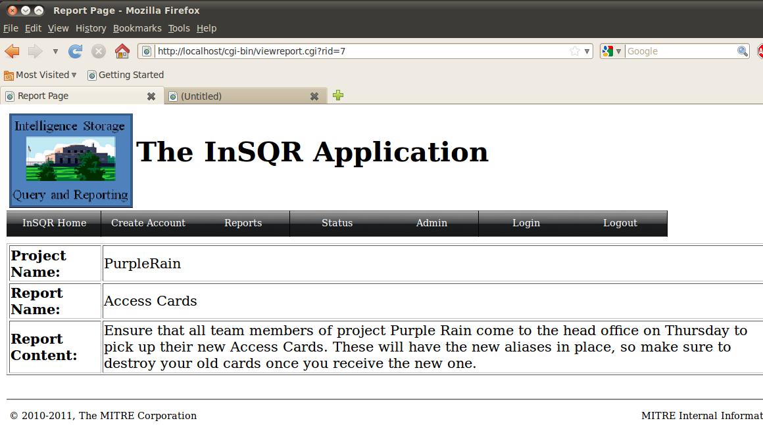
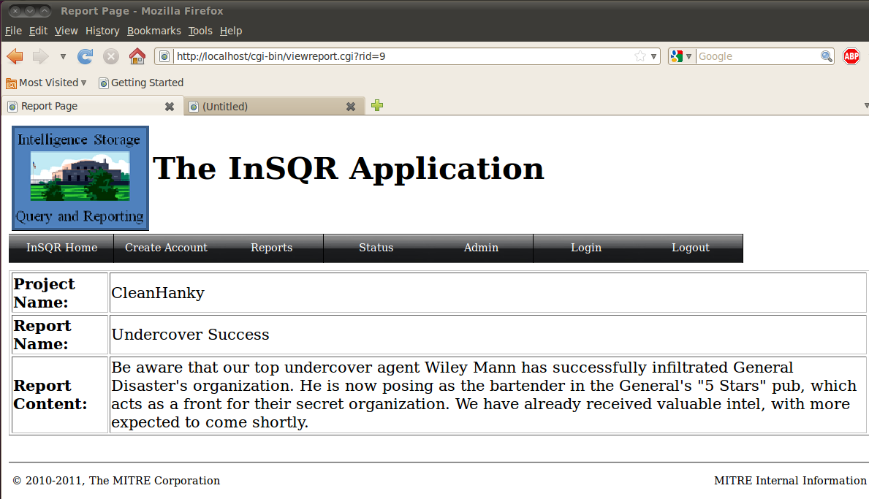
Context Change – Exploit Demo
Notes:
Demo – Log into the application with our compromised jdoe@iss.org credential. Click to view a report, and then simply change the number in the querystring / URL in the browser bar. Show that this provides access to a report that the user did not originally have access to.

Slide 9
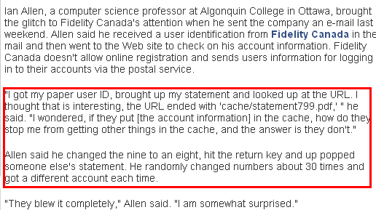
Real World Example – Fidelity Canada
Usually, when users can directly access a PDF or other non-code file from the web server, (e.g., resource is located in the web root) there is no opportunity for authorization code to execute.
With a predictable structure to the filename, it only takes minutes to create a script capable of retrieving all of the statements/reports on the site!
Notes:
In this real world example, the user was allowed to modify the document id in the URL and pull up financial statements for other people. If a predictable structure to the filename is used, it only takes minutes to create a script capable of retrieving all of the statements/reports on the site!

Slide 10
1 my $q = new CGI;
2
3 my $message_id = $q->param('id');
4
5 if (!AuthorizeRequest(GetCurrentUser())
6 {
7 ExitError("not authorized to perform this function");
8 }
9
10 my $Message = LookupMessageObject($message_id);
11
12 print "From: " . encodeHTML($Message->{from}) . "<br>\n";
13 print "Subject: " . encodeHTML($Message->{subject});
14 print "\n<hr>\n";
15 print "Body: " . encodeHTML($Message->{body}) . "\n";
While the program properly exits if authentication fails, it does not ensure that the message is addressed to the user. As a result, an authenticated attacker could provide any arbitrary identifier and read private messages that were intended for other users.
Notes:
While the program properly exits if authorization fails, it does not ensure that the message is addressed to the user. As a result, a user authorized to look at messages could provide any arbitrary identifier and read private messages that were intended for other users. One way to avoid this problem would be to ensure that the "to" field in the message object matches the username of the authenticated user.

Slide 11
Secure Coding …
1 my $q = new CGI;
2
3 my $message_id = $q->param('id');
4
5 my $Message = LookupMessageObject($message_id);
6
7 if (AuthorizeRequest(GetCurrentUser(), $Message))
8 {
9 print "From: " . encodeHTML($Message->{from}) . "<br>\n";
10 print "Subject: " . encodeHTML($Message->{subject});
11 print "\n<hr>\n";
12 print "Body: " . encodeHTML($Message->{body}) . "\n";
13 }
14 else
15 {
16 ExitError("not authorized to view message");
17 }
Notes:
To correct the code, the message being requested is added to the authorization request. Verification is now made that the user is authorized to retrieve the message being requested.

Slide 12
Authorization Words to Live By: #3
Any client/server application must verify security on the server
CWE-602: Client-Side Enforcement of Server-Side Security
  The software is composed of a server that relies on the client to implement a mechanism that is intended to protect the server. An attacker can modify the client-side behavior to bypass the protection mechanisms.
Notes:
The final words to live by for Authorization is "any client/server application must verify security on the server". This corresponds to CWE-602 titled "Client-Side Enforcement of Server-Side Security". An attacker can modify the client-side behavior to bypass the protection mechanisms. Note that this is also important with input validation, make sure the input is validated on the server and not on the client as an attacker can bypass any client side validation.

Slide 13
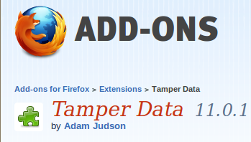
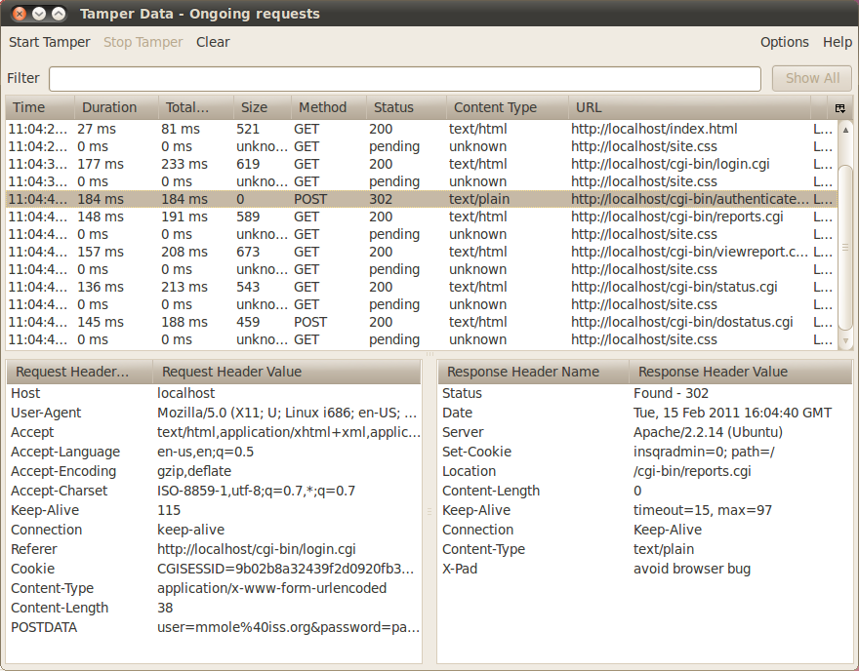
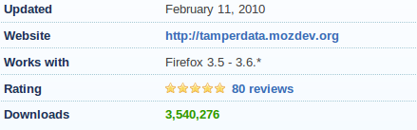
Client Enforced Security – Exploit Demo
Debug Proxies:
A key reason why a client
cannot be entrusted with
performing security.
Notes:
Demo - Using a debug proxy like Tamper Data is an easy way to see the requests coming from a client and modifying those requests before they reach the server. This demo show why a client cannot be trusted to make security decisions.

Slide 14
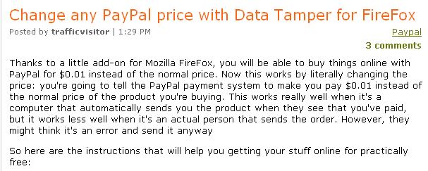
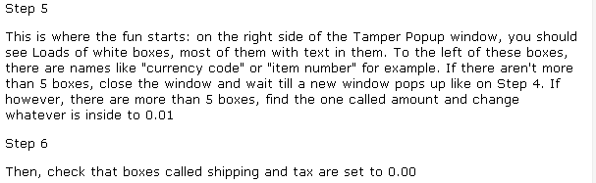
Real World Example – PayPal & Vendor Issue
Notes:
In 2009 it was discovered that PayPal was not validating the price on the server. So an attacker could modify the data being sent from the client and name their own price. There are many tools out there that enable an HTTP request to be caught and altered before being delivered to the server.

Slide 15
1 $customerid = AskForCustomerId();
2 $address = AskForAddress();
3
4 writeSocket($sock, "$user AUTH $customerid\n");
5 $resp = readSocket($sock);
6
7 if ($resp eq "authorized")
8 {
9 # request is authorized, go ahead and update the info!
10 writeSocket($sock, "$user CHANGE-ADDRESS $customerid $address\n");
11 }
12 else { print "ERROR: You're not authorized to change customer's address.\n"; }
Client
1 ($user, $cmd, $customerid, $address) = ParseRequest($sock);
2
3 if ($cmd eq "AUTH")
4 {
5 $result = AuthorizeRequest($user, $customerid);
6 writeSocket($sock, "$result\n");
7 }
8
9 elsif ($cmd eq "CHANGE-ADDRESS")
10 {
11 if (validateAddress($address)) {
12 $res = UpdateAddress($customerid, $address);
13 writeSocket($sock, "SUCCESS\n");
14 }
15 else { writeSocket($sock, "FAILURE -- address is malformed\n"); }
16 }
Server
Notes:
The client performs the authentication/authorization first and then only sends a CHANGE-ADDRESS for that user if the authentication succeeds. Because the client has already performed the authentication, the server assumes that the username in the CHANGE-ADDRESS is the same as the authenticated user. An attacker could modify the client by removing the code that sends the "AUTH" command and simply executing the CHANGE-ADDRESS.

Slide 16
Secure Coding …
1 $customerid = AskForCustomerId();
2 $address = AskForAddress();
3
4 writeSocket($sock, "$user CHANGE-ADDRESS $customerid $address\n");
5 $resp = readSocket($sock);
6
7 if ($resp ne "success")
8 {
9 error("$resp\n");
10 }
Client
1 ($user, $cmd, $customerid, $address) = ParseRequest($sock);
2
3 if ($cmd eq "CHANGE-ADDRESS")
4 {
5 $result = AuthorizeRequest($user, $customerid);
6 if ($result eq "authorized")
7 {
8 if (validateAddress($args))
9 {
10 $res = UpdateDatabaseRecord($customerid, $address);
11 writeSocket($sock, "SUCCESS\n");
12 }
13 else { writeSocket($sock, "FAILURE - malformed address\n"); }
14 else { writeSocket($sock, "FAILURE - not authorized\n"); }
15 }
Server
Notes:
In this fixed example, the authorization is done on the server as part of handling the CHANGE-ADDRESS request. The client does not have the ability to request this functionality separately.

Slide 17
Authentication
Authorization
Session Management
Data Validation
Error Handling
Logging
Encryption
Security Mechanism:
Session Management

Slide 18
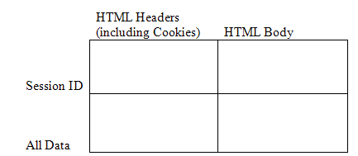
Session Management Core Concepts
The need to track state in a stateless protocol = Session Management
A session identifier becomes a “something you have” method of authentication.
Options for passing
data between browser
and web or app server.
Session lifetimes become a critical part of your application security.
Notes:
Any client / server or web application that wants to keep track of state, must perform some type of session management. In other words, in order to keep track of a user's place in a multi-stage process (e.g., a workflow), certain information must be passed in order to know where in the process the user currently is. Often, data collected at one point in the workflow is used to make decisions at another point. Therefore this data needs to be tracked throughout the process.
A simple example of this is authentication. Many client / server applications require a user to authenticate (log in) as the first step. The authentication information from step 1 is used to determine if the request for step 2 or step 3 is allowed. If the authentication state was not saved, then the user would have to log in with each request. Can you imagine the user's response if they had to enter their username and password every time they clicked a link in their online banking application? They would end up driving to the bank!!
Keeping track of this information related to a particular user can be accomplished a number of different ways. For example, the client application could store all the information provided and send it with each request made to the server. Another option would be for the client and server to agree on a unique "session ID" and for the server to store the information along with that id. Any client request would then only have to provide the unique session id and the server would be able to retrieve all the information related to that request. Both options above require the client to store something, either the information or the session id. There are two options for storing this information. It can be stored in the a cookie on the client system, or it can be stored in the HTML body as (hidden) form fields.
The quad chart on this slide represents the four possible combinations. It is important to understand these four combinations and the pros and cons associated with each.
If the application only needs to keep track of a small amount of information, then passing all the information with each request does not entail too much overhead and may be the easiest approach.
If a session ID is used, then this id needs to be protected with the same amount of vigor as one would protect the information that it maps to.

Slide 19
Session Management Words to Live By
Enforce a reasonable session lifespan
Leverage existing session management solutions
Force a change of session ID after a successful login
Notes:
There are three words to live by related to session management that we as developers must keep in mind. The first is to enforce a reasonable session lifespan so that if a session is compromised there is at least a limit to how long it can be exploited. (Hopefully it is compromised after it expires!) The second is to leverage existing session management solutions and avoid rolling your own. Finally, to avoid session fixation attacks, force a change of session ID after a successful login.

Slide 20
Session Words to Live By: #1
Enforce a reasonable session lifespan
CWE-613: Insufficient Session Expiration
  The lack of proper session expiration may improve the likely success of certain attacks. For example, an attacker may intercept a session ID, possibly via a network sniffer or Cross-site Scripting attack. Although short session expiration times do not help if a stolen token is immediately used, they will protect against ongoing replaying of the session ID. In another scenario, a user might access a web site from a shared computer (such as at a library, Internet cafe, or open work environment). Insufficient Session Expiration could allow an attacker to use the browser's back button to access web pages previously accessed by the victim.
Notes:
The first words to live by focuses on session expiration. A session that "lives" for a long time give an attacker either a long time to try and discover the session identifier, or gives them a long time to work within the session once the identifier has been discovered.

Slide 21
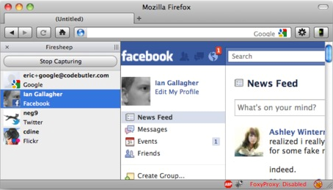
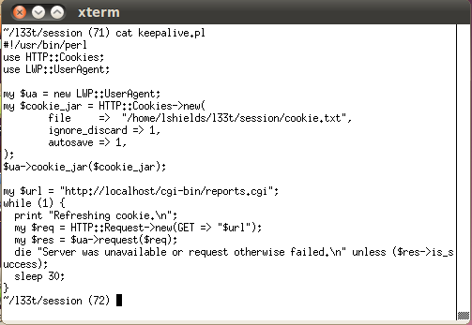
Session Lifespan – Exploit Demo
Determine or capture another user’s session ID – e.g., Firesheep
Keep the session alive and valid until the server reboots…
Notes:
Demo – Discuss how Firesheep works, but explain we won’t be doing a demo on that part because we’re not using an unsecured wireless network here. Discuss that the session could be compromised in other ways on the network, from PCAP logs, from application vulnerabilities like cross-site scripting, etc. The key is that a session can potentially become known to someone else, and when that happens the main objective is to limit the lifetime of usefulness to the attacker.
Show that placing the session ID value into the cookies.txt file in the l33t/session folder, and then running the keepalive.pl script will keep making valid requests… thus the inactivity timeout that is usually in place in many application servers will never be reached.

Slide 22
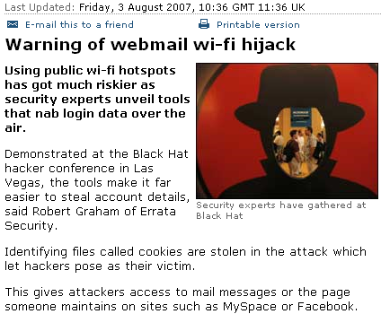
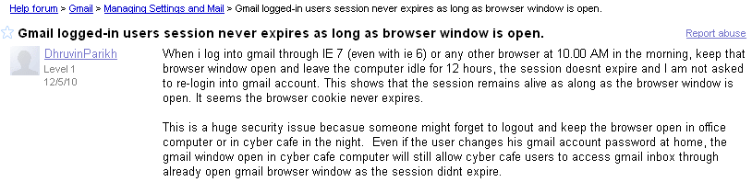
Real World – Session Lifetimes
Notes:
Note that the first article discusses the release of the tools that allow easier harvesting of session ID cookies that could be used to compromise sites like MySpace & Facebook. The article goes on to talk about Gmail also having the same vulnerability as well, and as can be seen people have raised the issue about a lack of session timeout around Gmail, even very recently. Mention that as a user – you can help protect yourself by remembering to use the ‘logout’ function on a site when you’re done using it, don’t just close the browser window.
*click to build slide* Point out that although FireSheep got a lot of press in the security news last year because it made it *so* easy for the script kiddie level attackers, over 3 years ago, people had already started releasing tools to exploit this weakness.

Slide 23
Secure Coding …
General rule of thumb
  30 minute timeout for inactivity
  12 hour hard time out
Session management setting are usually part of the application server configuration
  As developers we need to understand how these options affect our application and verify that the system admin has configured the server correctly
Notes:
As a general rule, sessions should timeout after 30 minutes of inactivity. In addition, after 12 hours the user should be asked to log in again. THe hard timeout is important since after a full day, most people need to go to sleep and a session that continues to be "active" is a sign that it has been potentially broken.
Note that most application servers implement an inactivity timeout, but very few provide a hard timeout option. This may be something that you as a developer needs to encode in you application.

Slide 24
Session Words to Live By: #2
Leverage existing session management solutions
CWE-331: Insufficient Entropy
CWE-334: Small Space of Random Values
CWE-642: External Control of Critical State Data
  The lack of proper session expiration may improve the likely success of certain attacks. For example, an attacker may intercept
It’s easier and generally more secure to use a vetted session management solution that has already been tested for these types of flaws.
Notes:
The second words to live by deals with leveraging existing session management solutions. Session management is complex and there are many opportunities to make mistakes. A lot of time has been put into existing solutions, and it is often better to leverage these solutions rather than build your own.

Slide 25
Session Strength – Exploit Demo
ACTIVE SESSIONS
-------------------------------------------
CGISESSID = 224b3666303552fd710867c8ac482a4
CGISESSID = 76a240fd7e228ee6e771a02d2c4921a
CGISESSID = ca3e617110de9fa3645a72c90f1677e
CGISESSID = ???????
ACTIVE SESSIONS
-------------------------------------------
CGISESSID = 1256
CGISESSID = 1257
CGISESSID = 1258
CGISESSID = ???????
Can you guess the next Session ID that will be issued in each case?
Notes:
Demo is a quick example of both strong and a weak session passing techniques in the application.

Slide 26
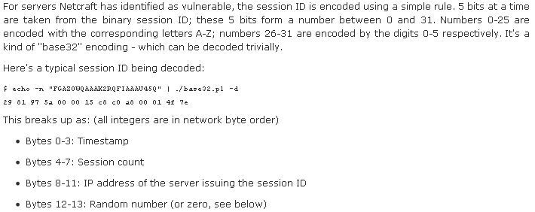
Real World – Session ID Weakness
Just because it looks random…
Timestamp goes up predictably, session count just increments, IP is
static, and the 2 random bytes at the end are fixed at server start time.
Notes:
We discuss the vulnerability in the Java WebServer, including the application server used by IBM WebSphere. Even though the string looks very random at first glance… it doesn’t hold up to more scrutiny. Walk through the flow of “get one session at 12:00:00, get another at 12:00:05”. Notice that the session count went from 10 to 12. That means someone else got a session somewhere between 12:00:00 and 12:00:05. Just replay all those static values and try 6 times… one for each second that the session *might* have been created in. This can be done in mere moments via automation.

Slide 27
Secure Coding …
As developers …
  We need to recognized when we need session management
  We know not to roll our own

Slide 28
Session Words to Live By: #3
Force a change of session ID after a successful login
CWE-384: Session Fixation
  Authenticating a user, or otherwise establishing a new user session, without invalidating any existing session identifier gives an attacker the opportunity to steal authenticated sessions.

Slide 29
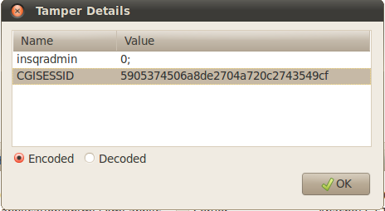
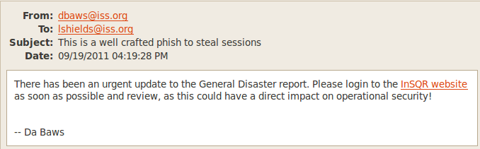
Session Fixation – Exploit Demo
Pre-Login
Post-Login
Send a ‘baited’ message to a target user.
Notes:
Demo – Show that when we first connect to the site, we are issued a CGISESSID value. After we successfully login, it’s still using the same session value. This means we know the site is vulnerable to a fixation attack, where an attacker can attempt to set the session of another user. Remember, if the attacker has the ‘something you have’ authentication item… they’re going to be the same as the person who has authenticated using that ID. To demonstrate, take the session ID out of the Tamper Data window, and going to the ~/l33t/session folder, run the ./fix-email script passing the “CGISESSID=….” as a command line parameter. This will send a specially crafted email to the demo user we’re using. Bring up the email tool, and show the email. By clicking the link to the website, it’s *really* the InSQR site, and it’s *really* the real login page with no other code. But the attacker has passed the session ID to use to the webserver in the querystring. The server trusts this as being the person’s session ID, and in fact, updates & sets a cookie for the user to contain that session ID going forward. When the victim logs in, they have now authenticated that session ID.
The attacker can now use that same session ID, still sitting at the login screen…just click ‘Reports’ and you’re good to go!

Slide 30
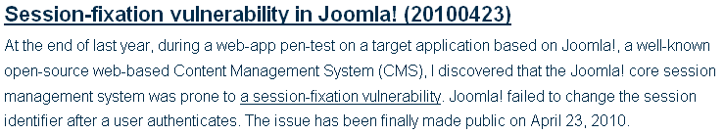

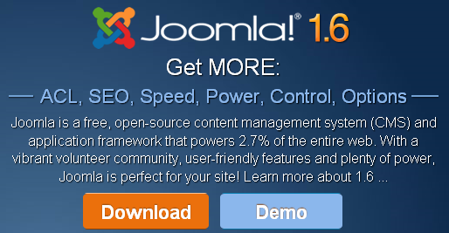
Real World – Session Fixation
Notes:
Even big applications include simple issues.

Slide 31
1 public int authenticate (HttpSession session)
2 {
3 string username = GetInput("Enter Username");
4 string password = GetInput("Enter Password");
5
6 // Check maximum logins attempts
7 if (session.getValue("loginAttempts") > MAX_LOGIN_ATTEMPTS)
8 {
9 lockAccount(username);
10 return(FAILURE);
11 }
12
13 if (ValidUser(username, password) == SUCCESS)
14 {
15 session.putValue("login", TRUE);
16 return(SUCCESS);
17 }
18 else return(FAILURE);
19 }
In order to exploit the code above, an attacker could first create a session (by visiting the login page of the application) from a public terminal, record the session identifier assigned by the application, and then leave the login page open. Next, a victim sits down at the same public terminal, notices the browser open to the login page of the site, and enters credentials to authenticate against the application. The code responsible for authenticating the victim continues to use the pre-existing session identifier, now the attacker simply uses the session identifier recorded earlier to access the victim's active session, providing nearly unrestricted access to the victim's account for the lifetime of the session.

Slide 32
Secure Coding …
1 public int authenticate (HttpSession session)
2 {
3 string username = GetInput("Enter Username");
4 string password = GetInput("Enter Password");
5
6 // Check maximum logins attempts
7 if (session.getValue("loginAttempts") > MAX_LOGIN_ATTEMPTS)
8 {
9 lockAccount(username);
10 return(FAILURE);
11 }
12
13 if (ValidUser(username, password) == SUCCESS)
14 {
15 // Kill the current session so it can no longer be used
16 session.invalidate();
17
18 // Create an entirely new session for the logged in user
19 HttpSession newSession = request.getSession(true);
20
21 newSession.putValue("login", TRUE);
22 return(SUCCESS);
23 }
24 else return(FAILURE);
25 }

